Slide 1

AIRBNB HOTEL BOOKING ANALYSIS
Subhamoy Hazra
INTERNSHIP_17546440516895be537820f

Slide 2

PROBLEM STATEMENT
AIRBNB is a popular platform where property owners rent out their homes or apartments to travelers. one of the biggest challenge for the host is deciding the right price for this listings, since price very depending on several factors such as the number of bedrooms, number of bathrooms, cleanliness, accuracy of description and communication quality with guests.

Slide 3
Project Description
This project focuses on building a machine learning model to predict the price of AIRBNB listings. Pricing all AIRBNB property correctly is crucial for both hosts and travelers. Hosts want to maximize occupancy and earnings, while travelers want a fair and competitive price. Using historical AIRBNB data, the project develops a regression model that learns relationships between listing attributes such as number of bedrooms, bathrooms, and guest rating, and the price charged. The model can be used to predict prices for new or hypothetical listings, helping property owners make informed pricing decisions.

Slide 4

WHO ARE THE END USERS?
AIRBNB Hosts: To optimize pricing of their listings based on property features and guest reviews.
Travelers: To evaluate whether a listing is overpriced or reasonably priced.
AIRBNB Platform Analysts: To improve automated pricing suggestions and increase platform trust.
Researchers/Students: To study the impact of property features and reviews on rental pricing.

Slide 5

Technology Used
Python- Core programming language
Pandas & NumPy- Datacleaning and preprocessing
Scikit-learn- Machine learning (model training, regression, evaluation)
Matplotlib/Seaborn- Data visualization and feature importance
Google Colab- Cloud based environment for running the project
File handling libraries- openpyxl (for Excel) and built in CSV handling

Slide 6
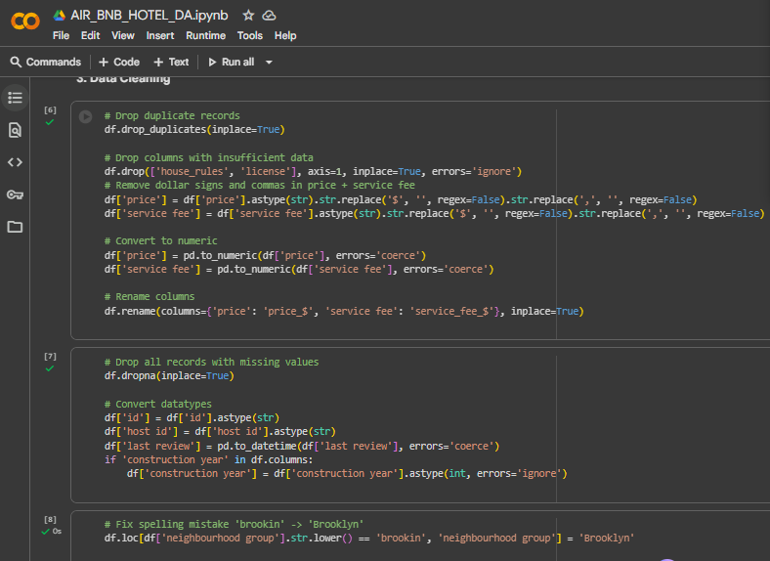
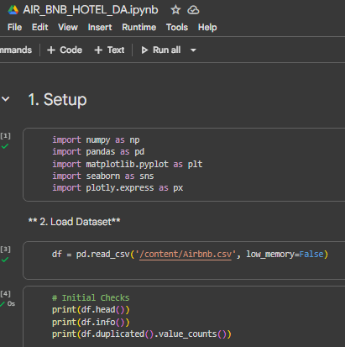
Python Code

Slide 7
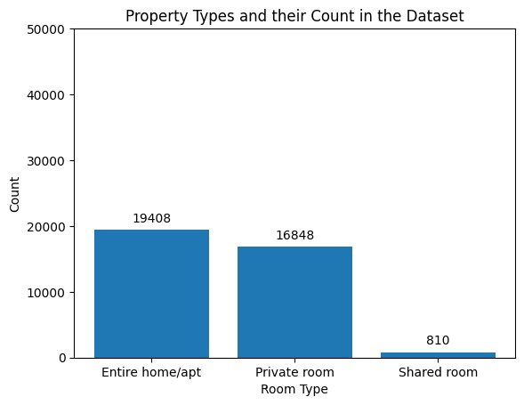
RESULTS1
Demo Link

Slide 8
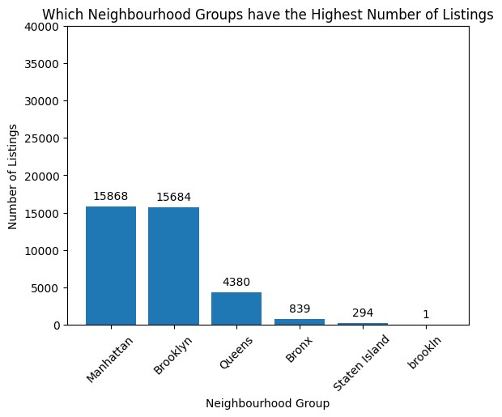
RESULTS2
Demo Link

Slide 9
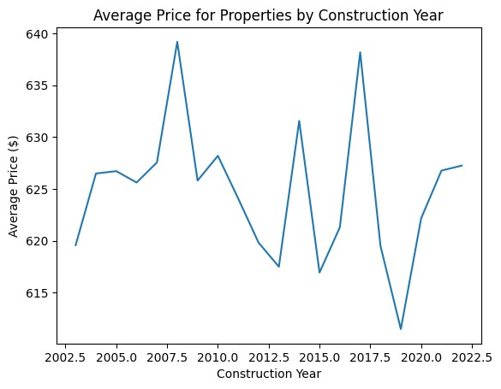
RESULTS3
Demo Link

Slide 10
GitHub repository
https://github.com/Su-Xmt-007/VOIS_AICTE_OCT2025_SUBHAMOYHAZRA.git
Demo Link

Slide 11
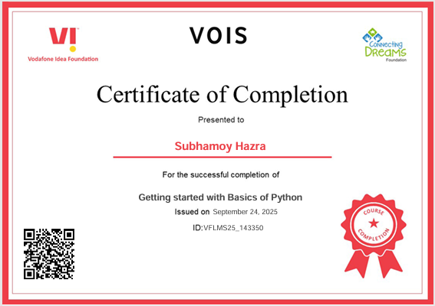
Getting started with Basics of Python Certificate

Slide 12
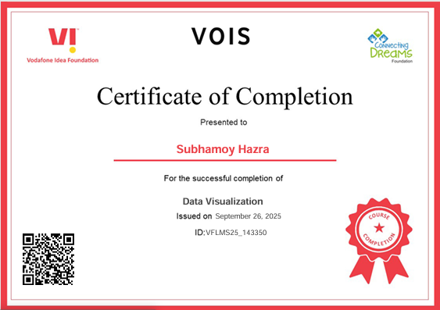
Data Visualization Certificate
[Paste your Certificate Here]

Slide 13
Thank you
.
.

